Slide 1
Previous Semester…
Image Processing Based Vehicle Detection and Tracking Method
Using Gaussian Mixture Model and EM Algorithm

Slide 2
What is a mixture model? Why we used Gaussian Distribution in a mixture model? Why did we switch to Rayleigh Mixture Model this time?

Slide 3
Rayleigh Mixture Model for Plaque Characterization in Intravascular Ultrasound
Vulnerable plaques are lesions presenting high risk of rupture, possibly leading to brain stroke or heart attack.
Plaque characterization is based on an IVUS study of the coronary arteries
Features are based on images reconstructed from the RF data
plaques are labeled according to their composition as lipidic, fibrotic or calcified

Slide 4
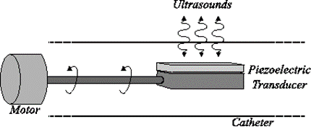
Intravascular Ultrasound
In medical ultrasound (US), a transmitted ultrasonic pulse interacts with an anatomical region providing information about internal tissue structures
The backscattered (received) signal is corrupted by a characteristic granular pattern noise called speckle , which depends on the number of scatterers (reflectors) as well as their size.
Intravascular US (IVUS) is an imaging technique that allows to clearly assess the arterial wall internal echomorphology.
The technical procedure of acquiring IVUS data consists in introducing a catheter, carrying a rotating US emitter inside the vessel. During rotation, a piezoelectric transducer transmits US waves and collects the reflected components that are afterward converted into electrical signals (A-lines) and sampled by an analog-to-digital converter.
The IVUS image obtained by processing the received echoes is a 360◦ topographic view of the inner arterial walls
Thus, IVUS is considered a suitable technique for in vivo characterization of the coronary plaques composition

Slide 5
Role of Rayleigh Mixture Model
This paper intends to model the plaque through the analysis of the envelope backscattered IVUS data.
For this purpose, an hypothetical model is considered, where a scanned tissue sample suffers from a certain number of scattering phenomena, as depicted in the most common model for speckle formation, known as fully developed speckle.
These scatterers arise from in homogeneity and structures approximately equal to or smaller in size than the wavelength of the US.
It is recognized that under fully developed speckle, pixel intensities in envelope images are very well modeled by Rayleigh probability density functions (PDFs).

Slide 6
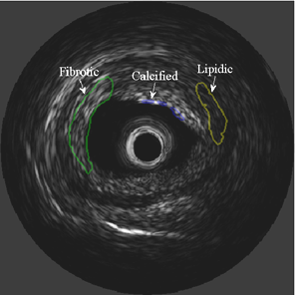
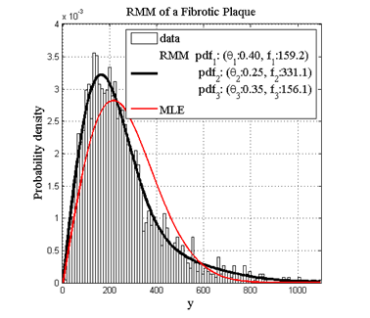
IVUS image showing three plaques (tissues) labeled according to their composition.
RMM estimated from the three labeled distinct plaques

Slide 8
Estimation of RMM parameters using EM algorithm

